Slide 1
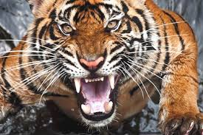
Problem Statement
Team Id:214
To Save people from wild animals entering into villages.
IoT Hackathon 2019

Slide 2
Customer Survey
We met many people some of them said It’s a pure luck to be saved some of them said we must suffer a lot at that time to survive.
Some of their problems are :
Domestic animals are being vanished.
Kids went for playing and the fact indigestible is they will never return.
Loss of lives.
IoT Hackathon 2019

Slide 3
Existing Solutions
Many people are using fencing.
Some of them are dare enough to fight but these are very rare
IoT Hackathon 2019

Slide 4
Our Solution
We are going to detect the wild animals which are very harmful to human kind.
After detecting we are going to produce a alert sound.
So that many lives can be saved.
We are going to inform forest department.
IoT Hackathon 2019

Slide 5
Value Proposition
We mainly focus on accuracy on detection of AI.
Neither Animals nor humans are going to get harm.
We think that our product delivers the needs of Village people. That may be basic , technical or in any other way.
IoT Hackathon 2019

Slide 6
Customers & Consumers
Our device used by people living in the village near forests.
Purchased by sarpanch and head of village.
IoT Hackathon 2019

Slide 7
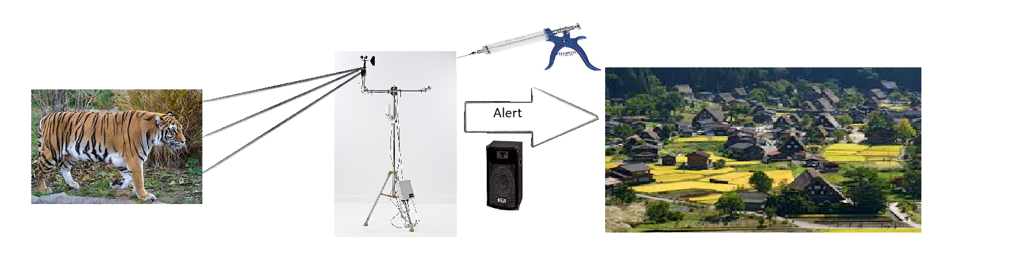
Design - Blueprint
IoT Hackathon 2019

Slide 8
Block Diagram
Detecting animals
Capturing
animals
Intimating forest department
Disturbing frequency of animals

Slide 9
Thank You!
IoT Hackathon 2019

